Slide 1
SC4 Results
GM
SOL
TA1
TA2

Slide 2
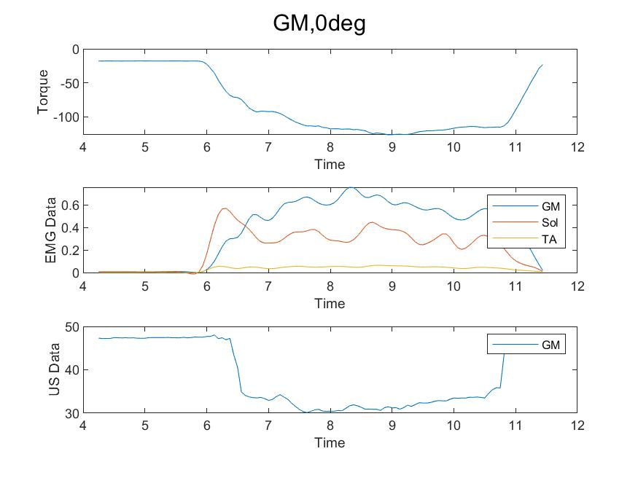
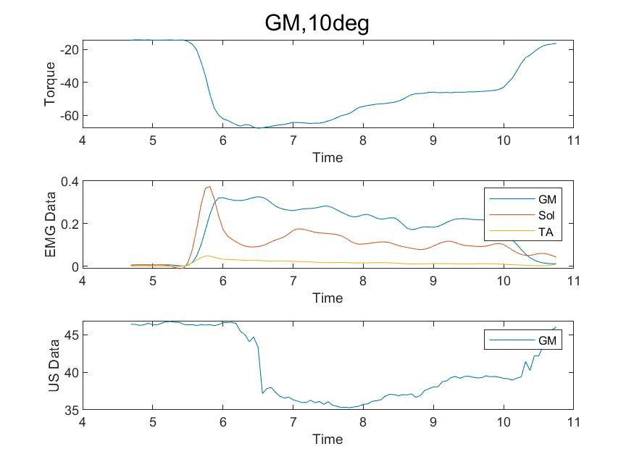
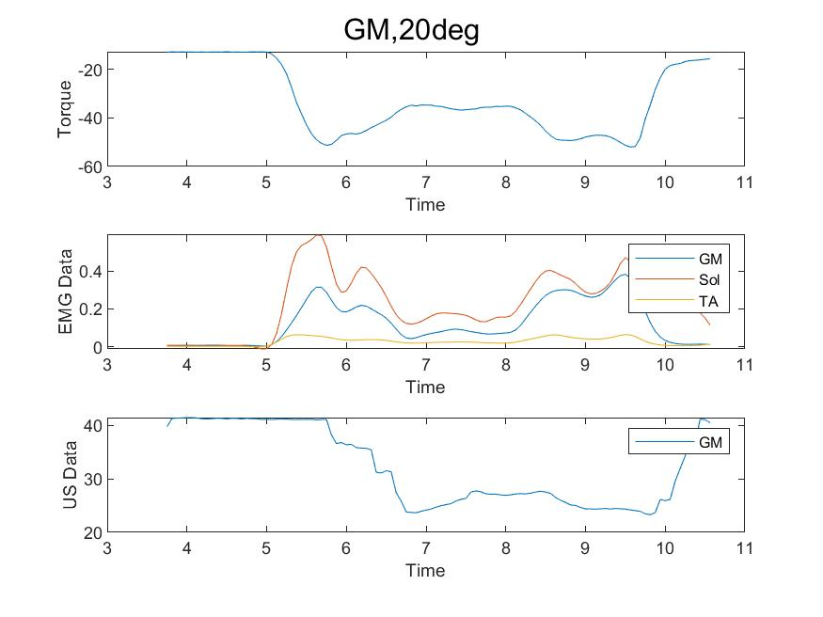
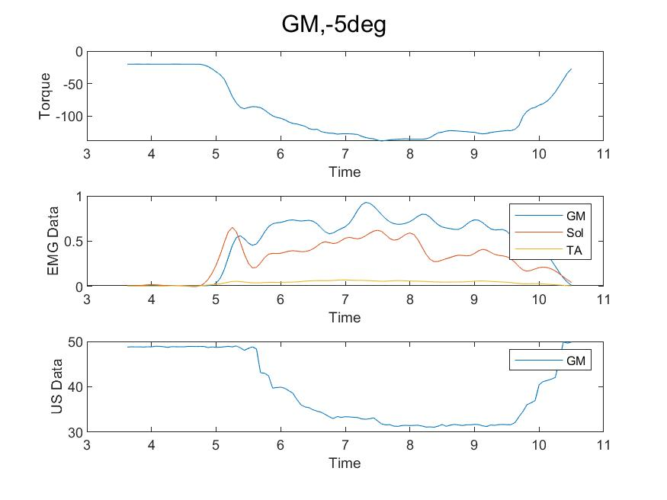
GM: Pre-processing
Comments:
Both the marker and the ultrasound tracking looks OK, but it’s still a bit unsynchronized.

Slide 3
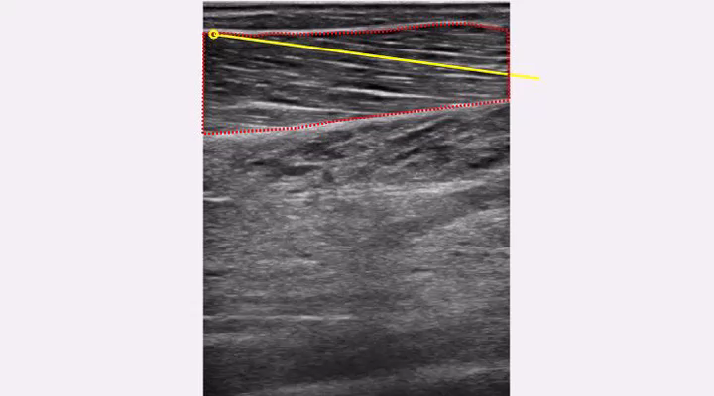
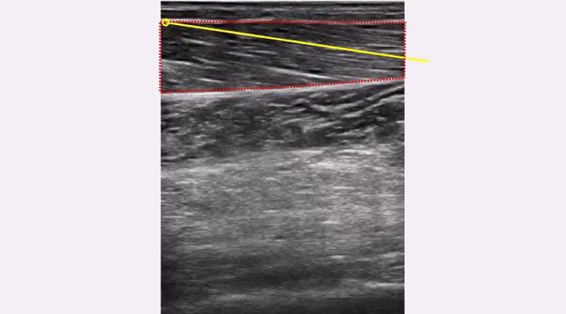
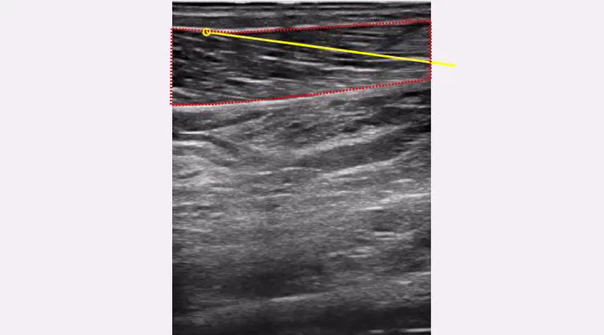
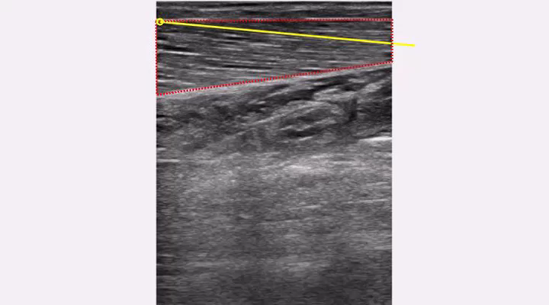
GM: Pre-processing, US Tracking
Comments:
0 degrees
10 degrees
20 degrees
-5 degrees

Slide 4
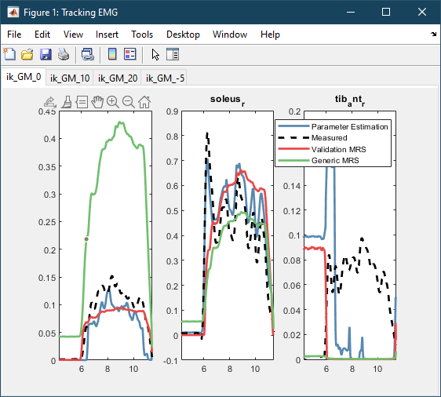
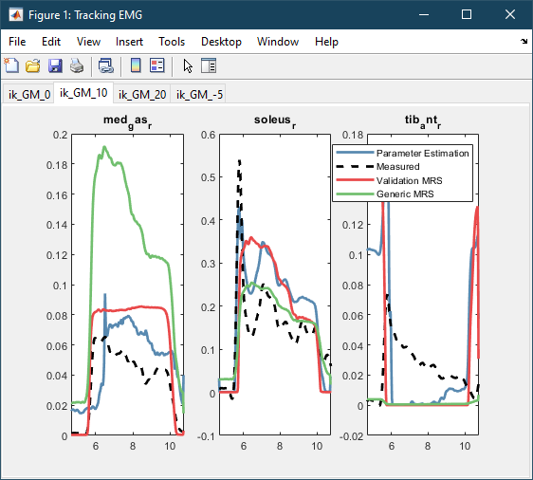
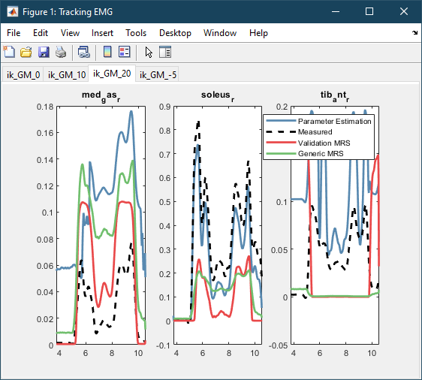
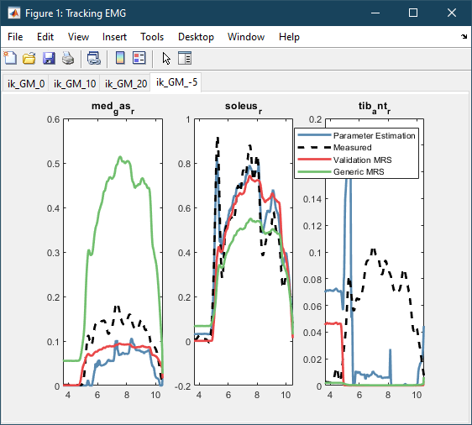
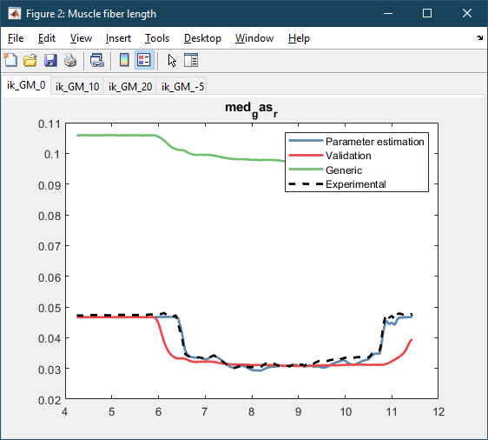
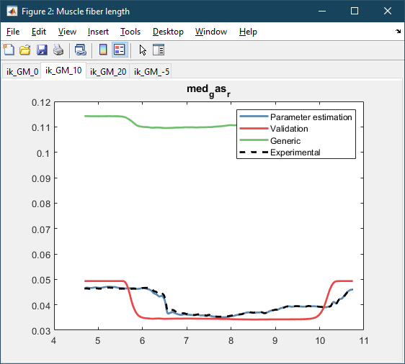
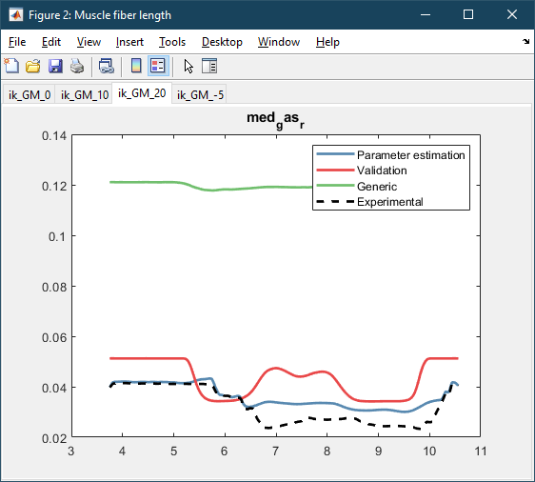
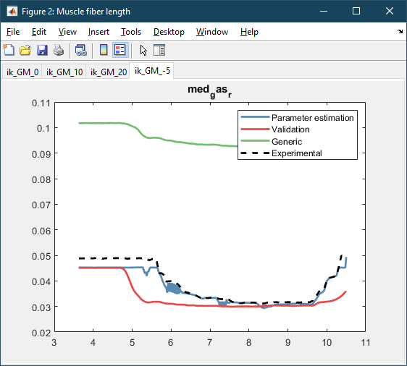
GM: Results
Weights:
wEMG = 0.001 wlM = 1 EMGbounds = [-0.1 0.1] BoundsScaleEMG = [0.2 1.5]
Comments:

Slide 5
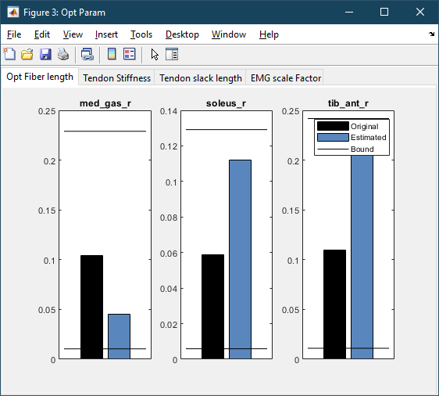
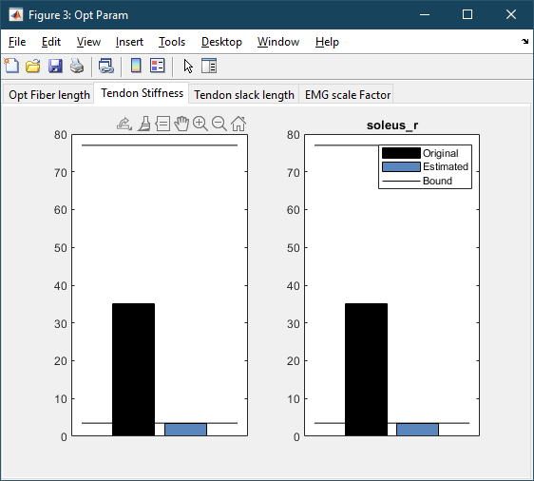
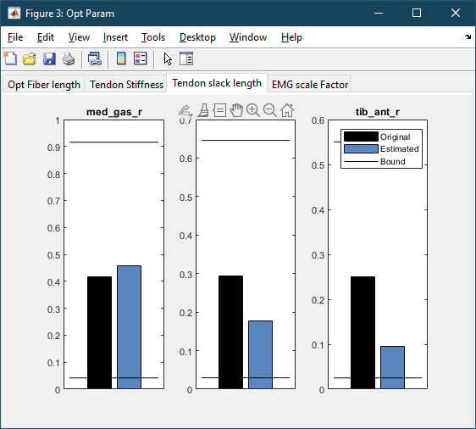
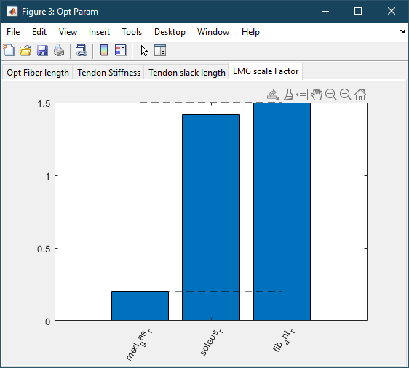
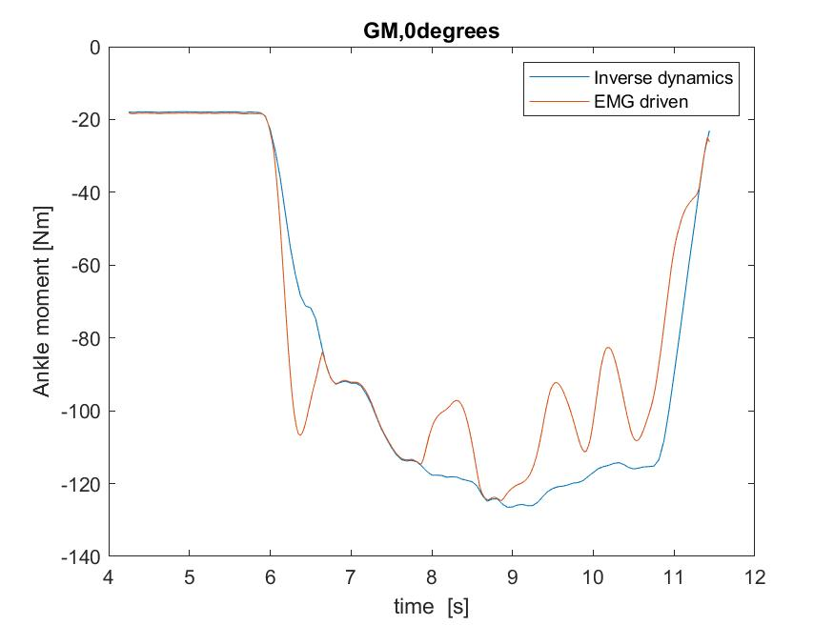
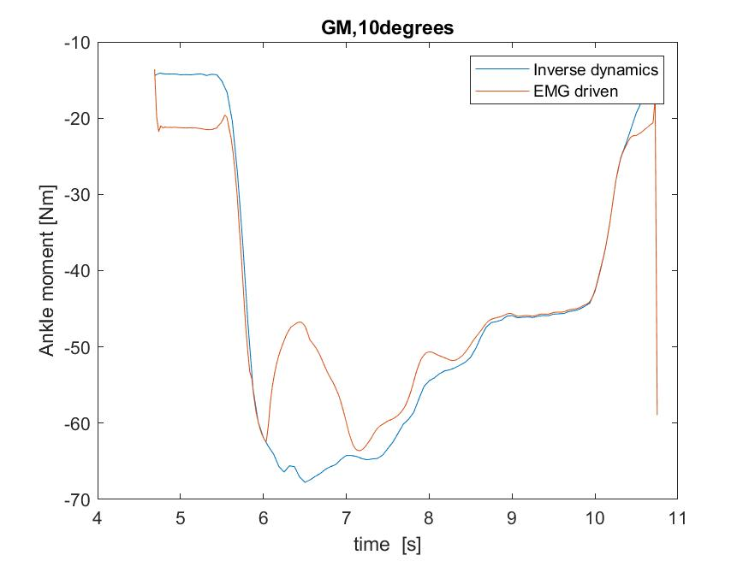
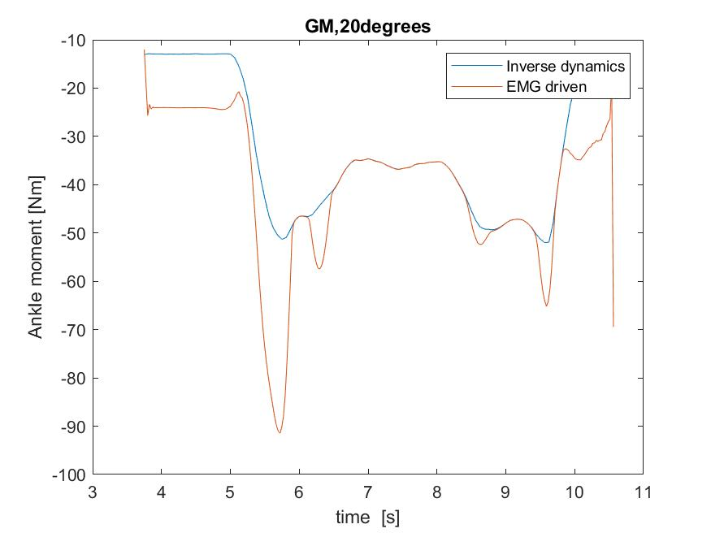
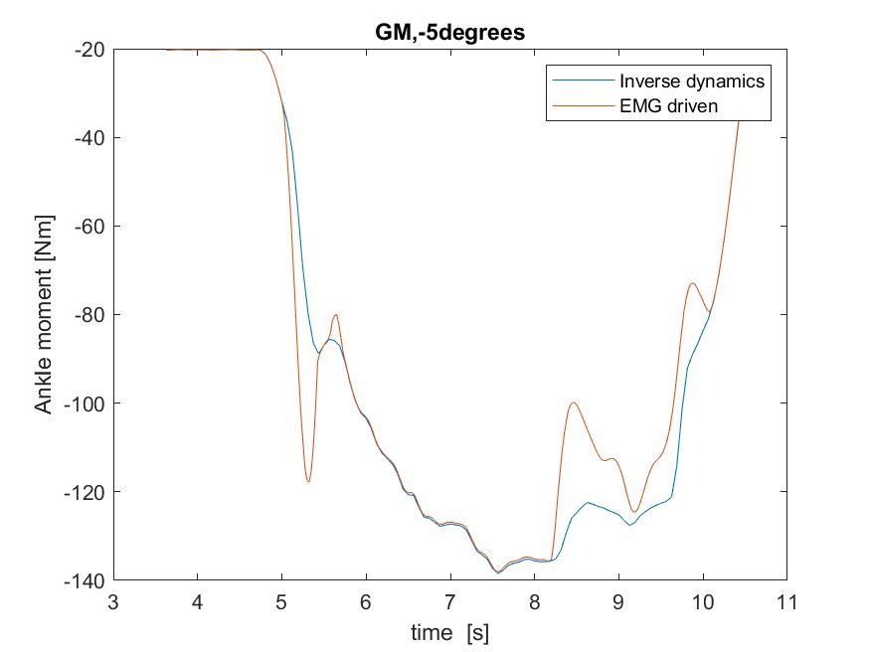
GM: Results
Weights:
wEMG = 0.001 wlM = 1 EMGbounds = [-0.1 0.1] BoundsScaleEMG = [0.2 1.5]
Comments:

Slide 6
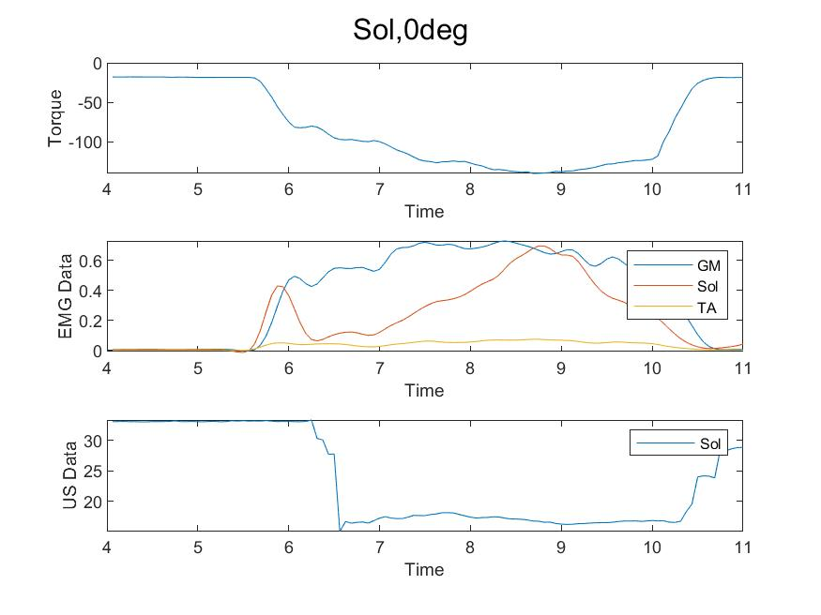
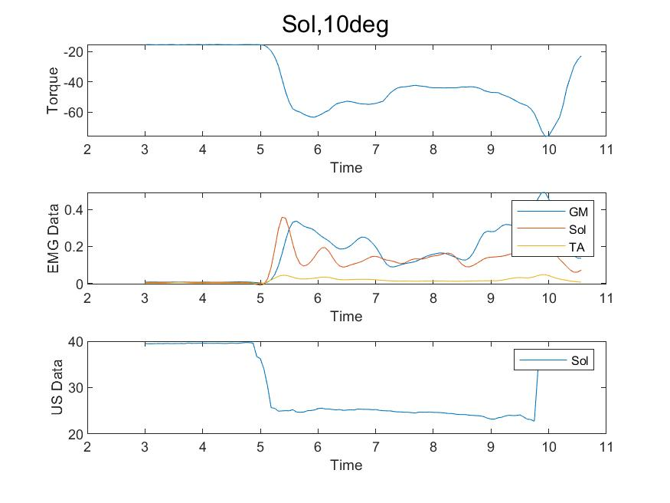
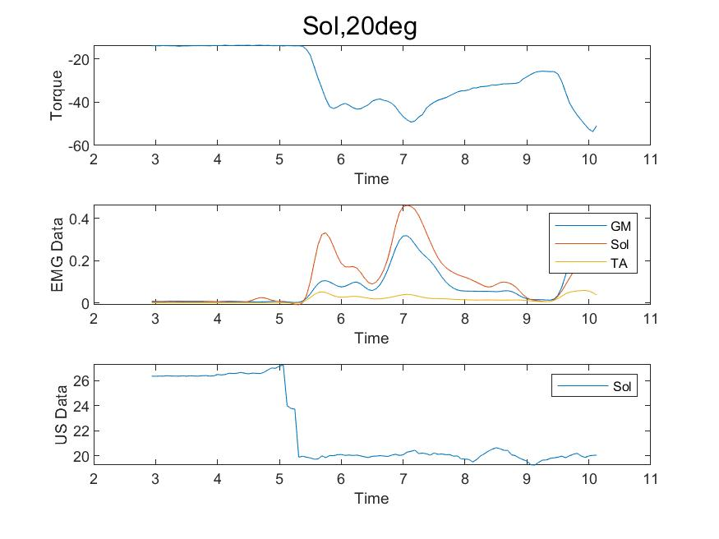
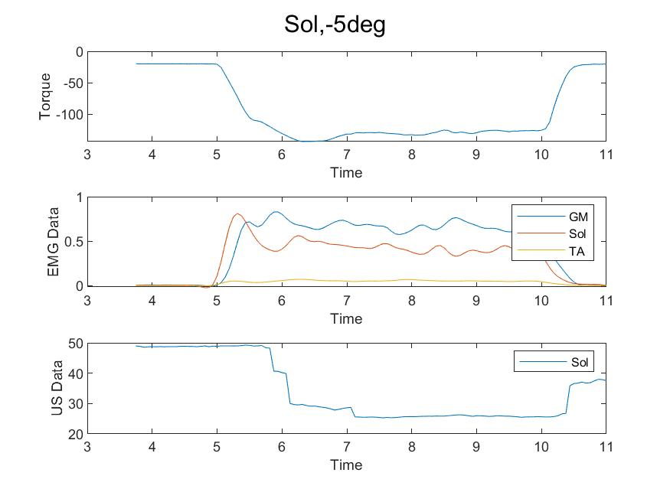
SOL: Pre-processing
Comments:
Both the marker and the ultrasound tracking looks OK, but it’s still a bit unsynchronized.

Slide 7
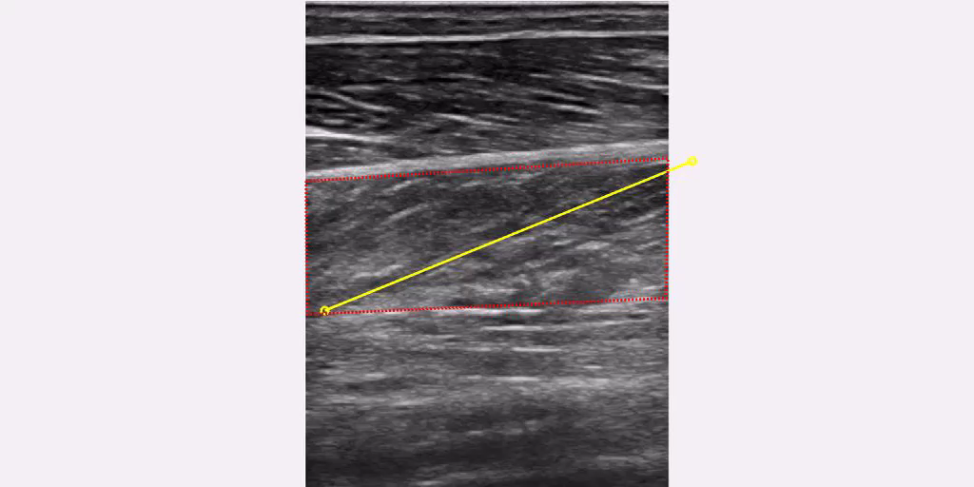
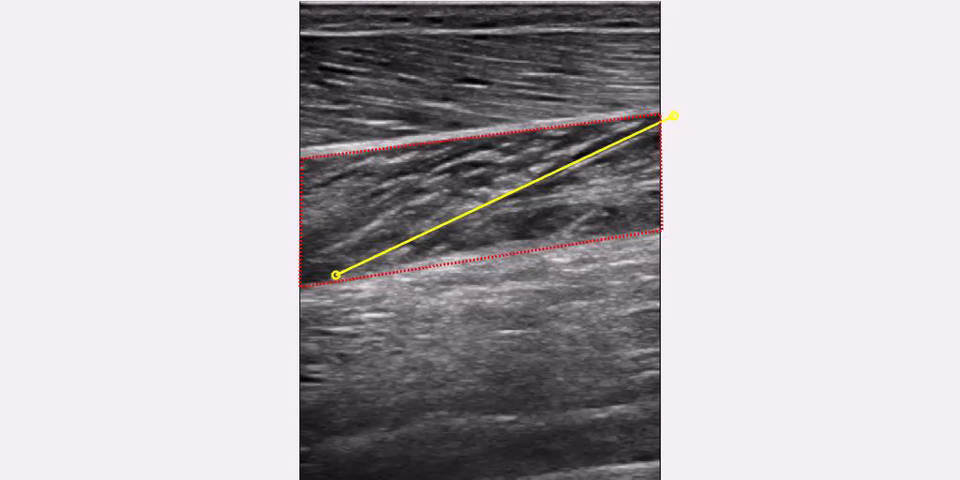
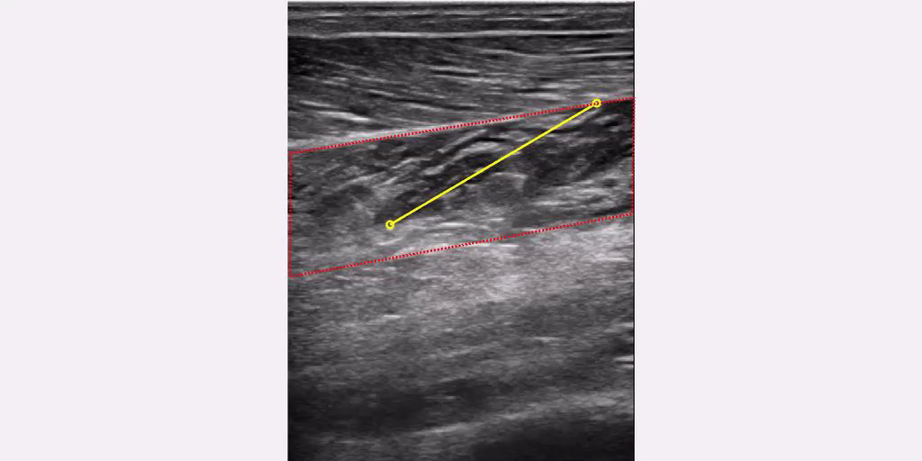
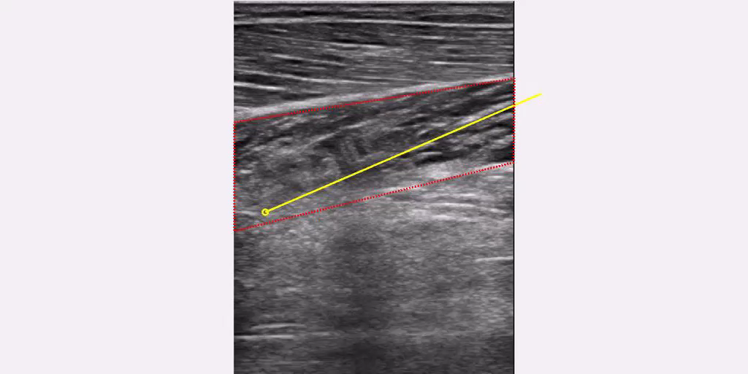
SOL: Pre-processing, US Tracking
Comments:
0 degrees
10 degrees
20 degrees
-5 degrees

Slide 8
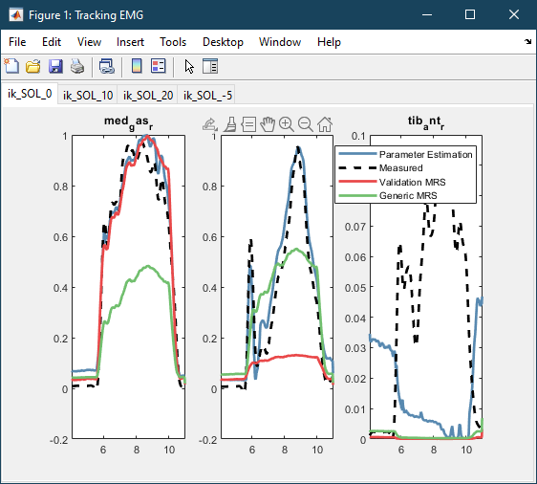
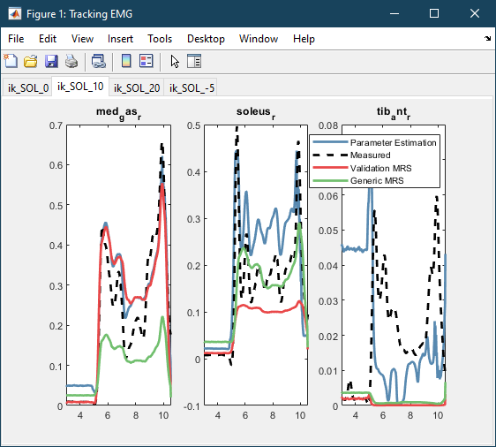
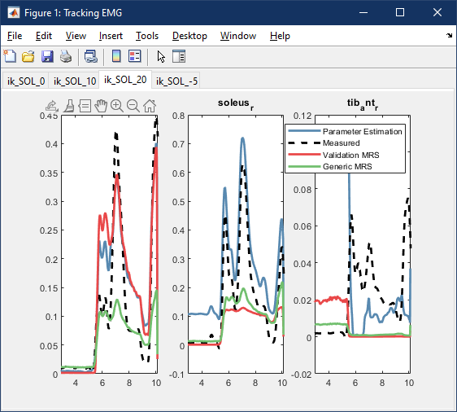
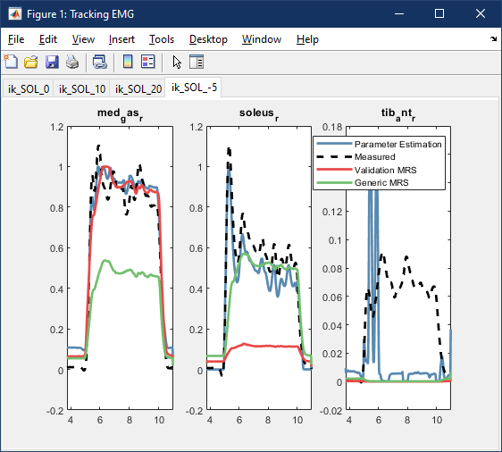
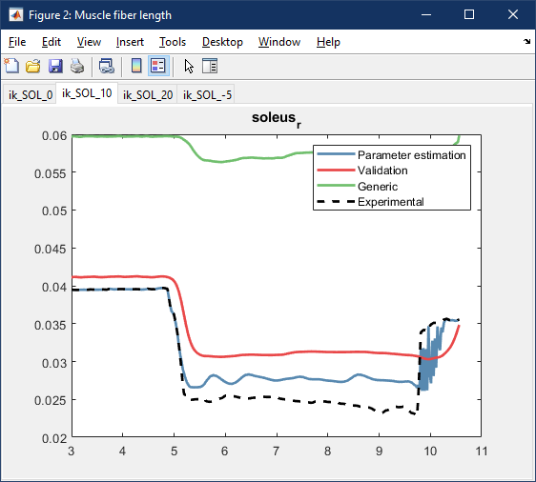
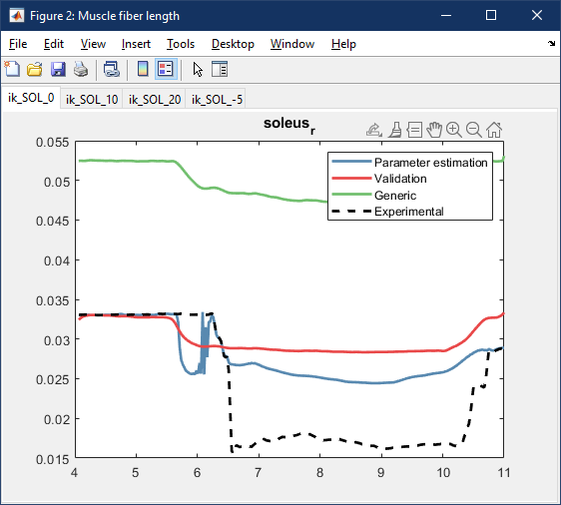
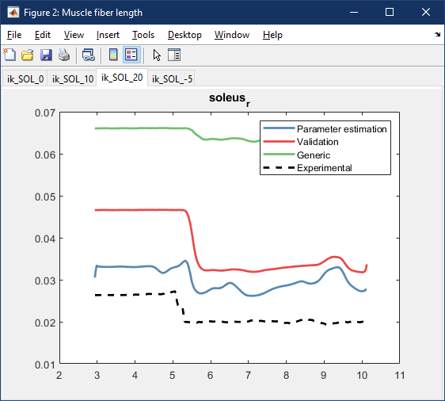
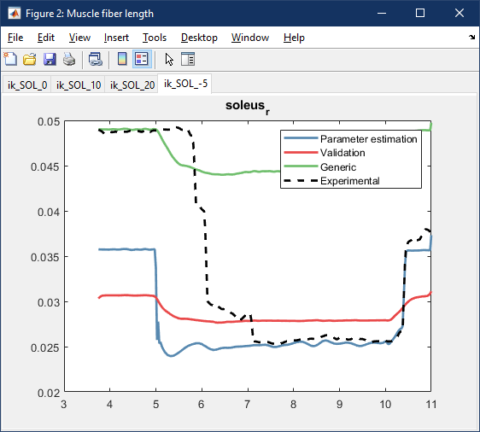
SOL: Results
Weights:
wEMG = 0.001 wlM = 1 EMGbounds = [-0.1 0.1] BoundsScaleEMG = [0.2 1.5]
Comments:

Slide 9
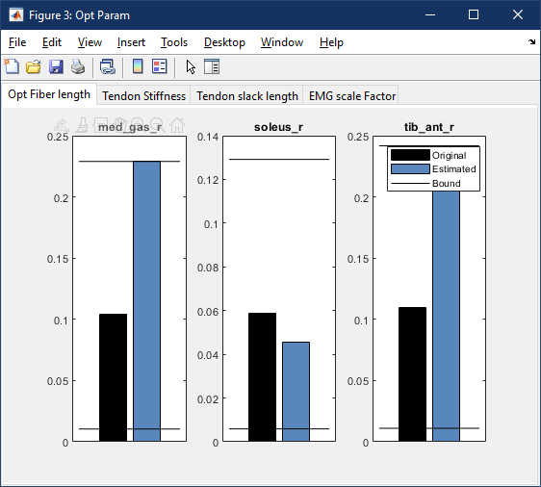
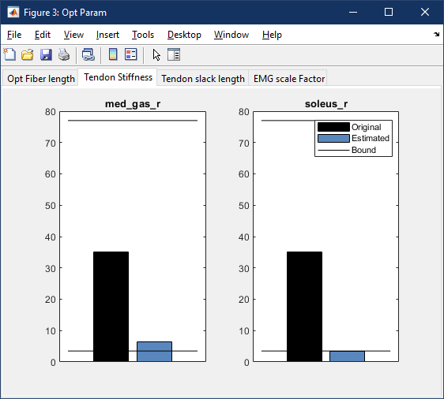
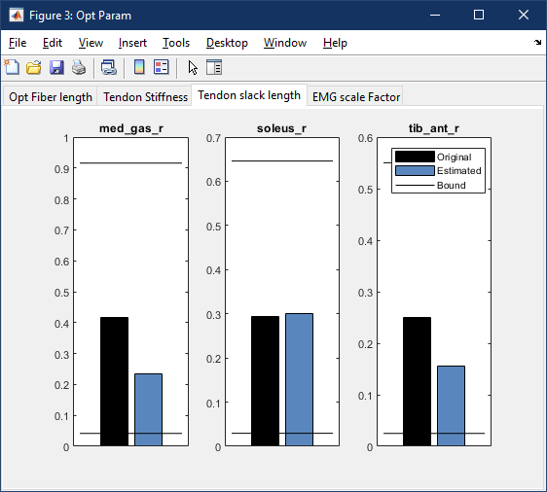
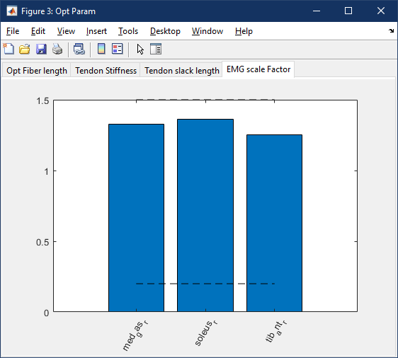
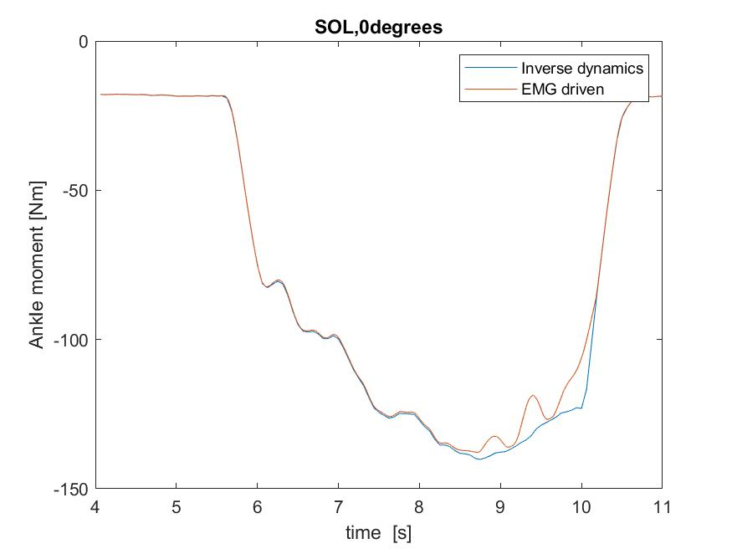
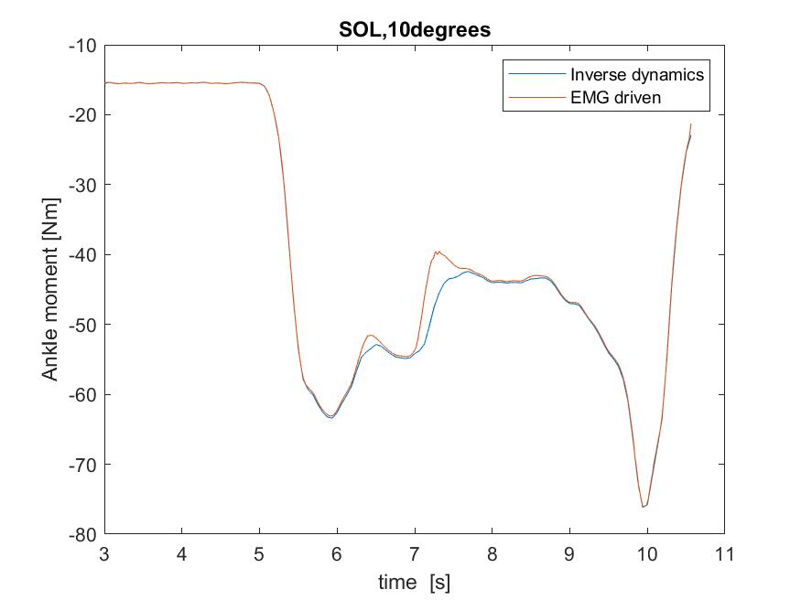
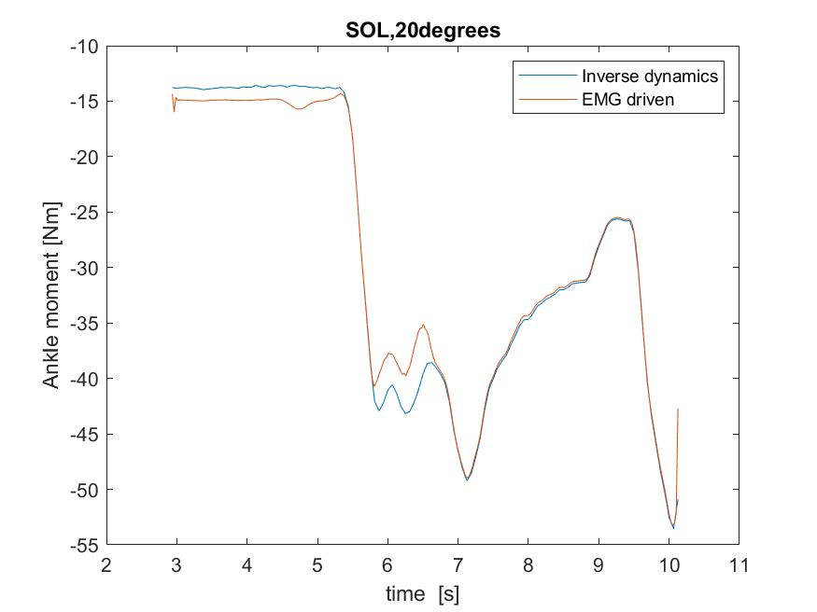
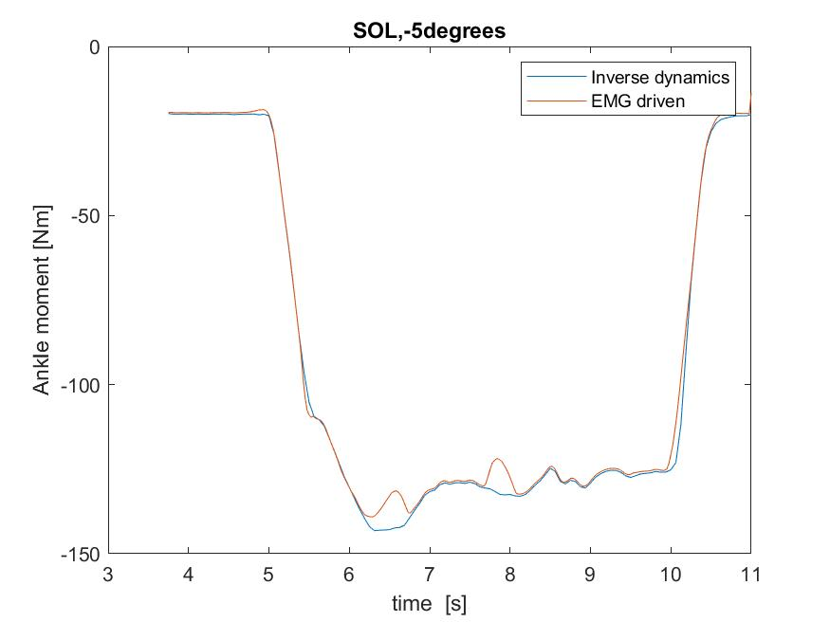
SOL: Results
Weights:
wEMG = 0.001 wlM = 1 EMGbounds = [-0.1 0.1] BoundsScaleEMG = [0.2 1.5]

Slide 10
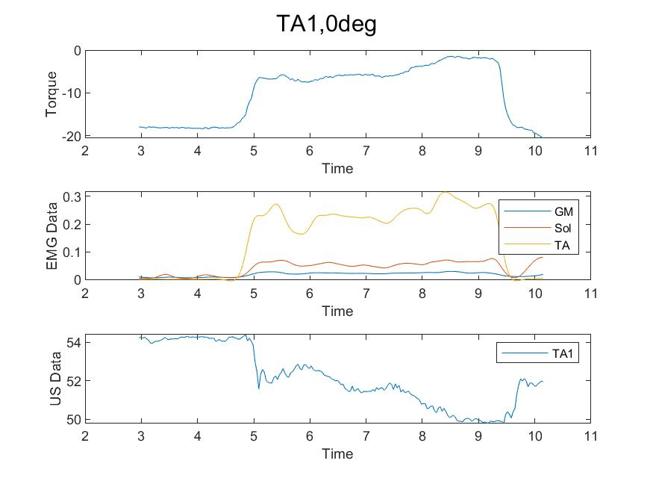
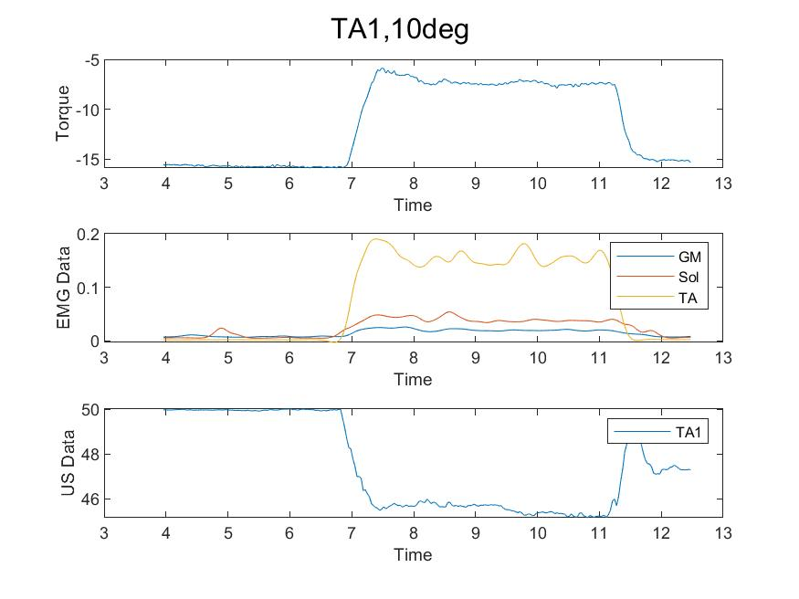


TA1: Pre-processing
Comments:
Both the marker and the ultrasound tracking looks OK, but it’s still a bit unsynchronized.

Slide 11




TA1: Pre-processing, US Tracking
Comments:
0 degrees
10 degrees
20 degrees
-5 degrees

Slide 12








TA1: Results
Weights:
wEMG = 0.001 wlM = 1 EMGbounds = [-0.1 0.1] BoundsScaleEMG = [0.2 1.5]
Comments:

Slide 13








TA1: Results
Weights:
wEMG = 0.001 wlM = 1 EMGbounds = [-0.1 0.1] BoundsScaleEMG = [0.2 1.5]

Slide 14




TA2: Pre-processing

Slide 15




TA2: Pre-processing, US Tracking
Comments:
0 degrees
10 degrees
20 degrees
-5 degrees

Slide 16








TA2: Results
Weights:
wEMG = 0.001 wlM = 1 EMGbounds = [-0.1 0.1] BoundsScaleEMG = [0.2 1.5]
Comments:

Slide 17








TA2: Results
Weights:
wEMG = 0.001 wlM = 1 EMGbounds = [-0.1 0.1] BoundsScaleEMG = [0.2 1.5]

